Slide 1
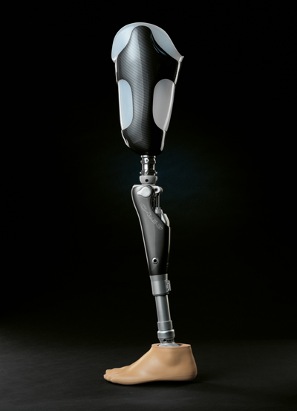
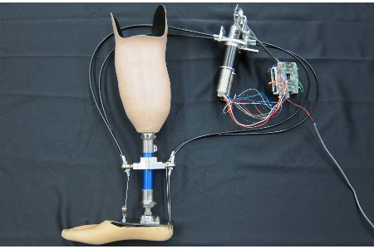
Prosthetic Limbs
By: Chloe MacDonald

Slide 2
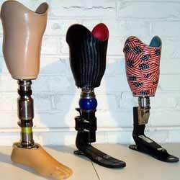
424 b.c to 1 b.c
In Capua, Italy, an artificial leg was found. It was made out of bronze and iron, which was also for the use of a below the knee amputee.

Slide 3
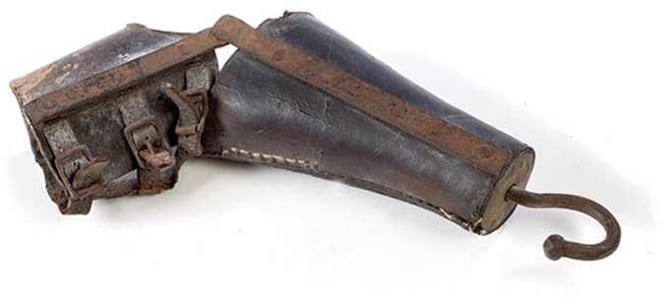
476 to 1000
All prosthetics during this age were mainly peg legs and hand hooks.
Most of these prosthetics were made for hiding deformities or injuries sustained in battle.

Slide 4
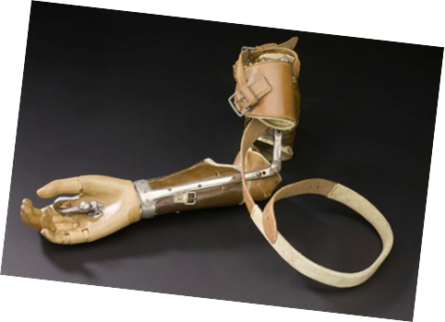
1400s to 1800s
During the Renaissance, prosthetics were generally made out of iron, steel, copper and wood.
The Renaissance was also known as the rebirth of prosthetics.

Slide 5
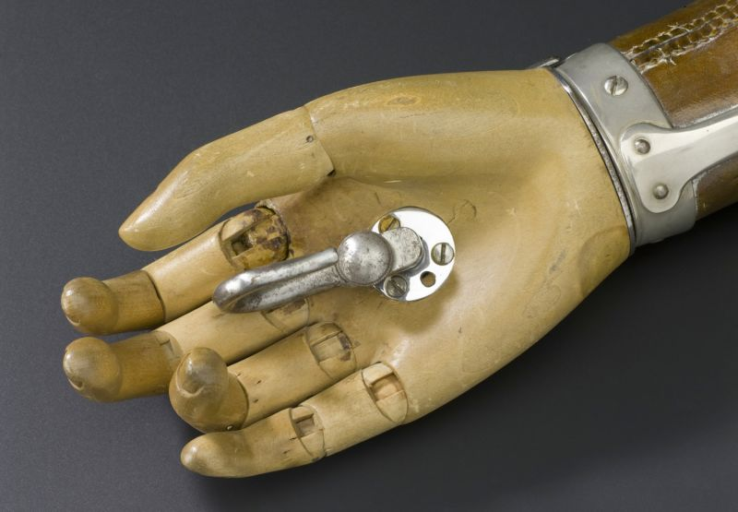
The early 1500s
In 1508, a German mercenary had a pair of technologically advanced iron hands after losing his right arm in battle.
Theses hands could be moved by relaxing a series of releases and springs while being suspended with a leather strap.

Slide 6
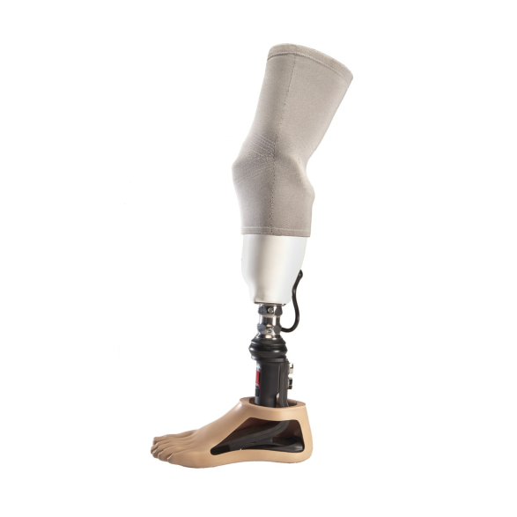
Mid to late 1500s
Advanced prosthetics for upper and lower-extremity amputees were made.
One of the most important contributions to the field was made when leather, paper, and glue was used in place of a heavy iron in making a prosthetic.

Slide 7
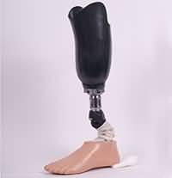
1696
In 1696, Pieter Verduyn made the first nonlocking below knee prosthetic, which would later become the blueprint for current joint and corset devices.

Slide 8
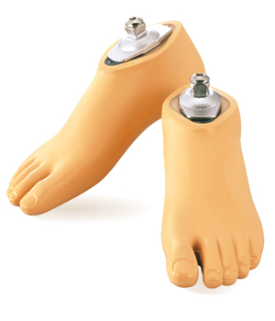
1843
In 1843, Sir James Syme discovered a new method of ankle amputation that did not involve amputating at the thigh.
This was welcomed in the amputee community because it meant there was a possibility of walking again with a foot prosthetic instead of a leg prosthetic.

Slide 9
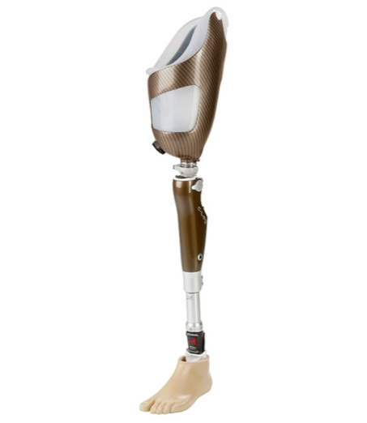
1863
In 1863, Dubois Parmlee invented an advanced prosthetic that included a suction socket, polycentric knee and multi-articulated foot.
It was later suggested to used aluminum instead of steel to make artificial limbs lighter and more functional.

Slide 10
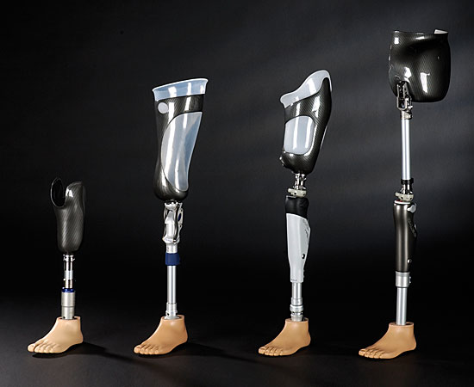
Modern prosthetics
In addition to being lighter, the advent of microprocessors, computer chips, and robotics in today’s devices are designed to return amputees to the lifestyle they were accustomed to.
Prosthetics are now more realistic with silicone covers and are able to mimic the function of a natural limb.

Slide 11
Citations
http://www.amputee-coalition.org/resources/a-brief-history-of-prosthetics/
http://www.tuvie.com/wp-content/uploads/c-leg.jpg
http://ehealth.eletsonline.com/wp-content/uploads/2015/09/lower-limb.jpg
https://www.asme.org/getmedia/5f577bc9-0f06-4026-99d6-da96cba3ae5a/The_Civil_War_Birth_of_US_Prosthetics_Industry.jpg.aspx?width=680
http://static6.businessinsider.com/image/53f38b41eab8eaf82ad01607/artificial-limbs-have-gone-through-an-amazing-evolution.jpg
http://vertassets.blob.core.windows.net/image/7e886185/7e886185-25e6-4524-831d-256950c65145/mtu_prosthetic_leg_1_.jpg
http://www.centro-de-innovacion.com/media/images/29310_c-leg-kpl_21_1380-4c_contentslider.jpg
http://3.imimg.com/data3/EC/DV/MY-2938640/below-knee-prosthesis-250x250.jpg
http://i.kinja-img.com/gawker-media/image/upload/s--Uh7VKj_A--/c_scale,fl_progressive,q_80,w_800/u4xc0oj6oelwmk1jvvfz.jpg
http://www.imasengiken.co.jp/en/lapoc/image/m1170_main.jpg
http://hortonsoandp.com/wp-content/uploads/2014/11/leg3547603e018b1a.jpg
http://media.ottobock.com/prosthetics/socket-technologies/harmony/harmony-p3/images/harmony_vacuum_system_1_1_teaser_fallback_retina.jpg

