Slide 2
THIS
IS
Jeopardy

Slide 3
With
Your
Hosts...
Abby and Maggie

Slide 4



Jeopardy
Column A
Science
A.N
Column C
History
M.C
Column D
Fashion
A.N
Column E
Pop Culture
M.C
Column F
Food
A.N
Column B
Movies
M.C
100
100
100
100
100
100
200
200
200
200
200
200
300
300
300
300
300
300
400
400
400
400
400
400
500
500
500
500
500
500

Slide 5
Why does heat rise?
A 100

Slide 6
What is when you heat air, it expands? Hot air is less dense then cold air.
A 100

Slide 7
Define revolution
A 200

Slide 8
What is, the movement of one object around a center or another object?
A 200

Slide 9
What is the Coriolis Effect?
A 300

Slide 10
What is, how a moving object seems to veer toward the right in the Northern hemisphere and left in the Southern hemisphere?
A 300

Slide 11
Who is Alfred Wegener?
A 400

Slide 12
Who is, scientist who discovered the continental drift theory.
A 400

Slide 13
What weather occurs at a Stationary Front?
A 500

Slide 14
What is, where the warm and cold air meet, clouds and fog form, and it may rain or snow?
A 500

Slide 15
Who directed Avengers: Endgame?
B 100

Slide 16
Who are The Russo brothers?
B 100

Slide 17
Who played Cher Horowitz in Clueless?
B 200

Slide 18
Who is Alicia Silverstone?
B 200

Slide 19
Who played Buddy the Elf in Elf (2003)?
B 300

Slide 20
Who is Will Ferrell?
B 300

Slide 21
When did the Princess Diaries come out?
B 400

Slide 22
What is 2001?
B 400

Slide 23
How much has Star Wars made from ALL their movies?
B 500

Slide 24
What is $65 billion?
B 500

Slide 25
Who was the first president of the United States?
C 100

Slide 26
Who is George Washington?
C 100

Slide 27
What type of government does South Korea have?
C 200

Slide 28
What is Democratic Republic?
C 200

Slide 29
What did Egyptians call their rulers?
C 300

Slide 30
Who are the Pharaohs?
C 300

Slide 31
Daily
Double
C 400

Slide 32
What was Lucy’s species?
C 400

Slide 33
What is Australopithecus afarensis?
C 400

Slide 34
What started World War I?
C 500

Slide 35
What is The assassination of Archduke Franz Ferdinand of Austria-Hungary?
C 500

Slide 36

What type of fabric is this?
D 100

Slide 37
What is Gingham?
D 100

Slide 38
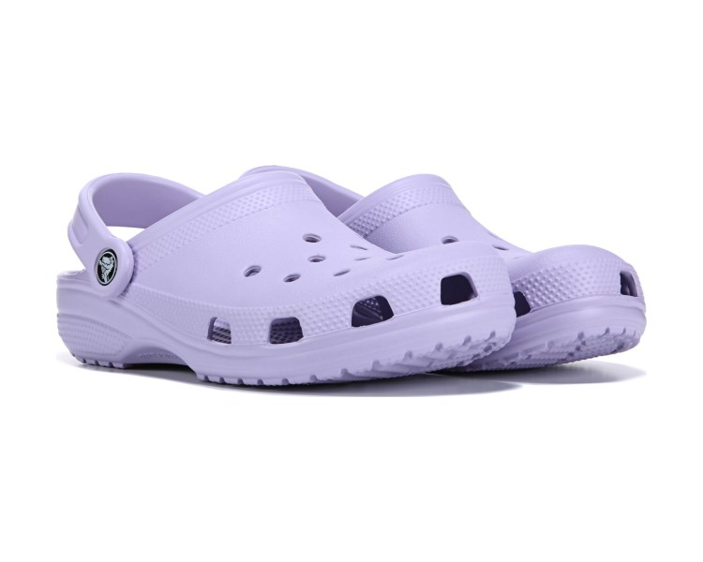
When was crocs invented?
D 200

Slide 39
What is 2002?
D 200

Slide 40
When were neon colored clothes popular?
D 300

Slide 41
What is 1980’s?
D 300

Slide 42
When/where was Gucci founded?
D 400

Slide 43
What is 1921, Florence, Italy?
D 400

Slide 44
Who was the famous model in the 1960’s?
D 500

Slide 45
Who is Twiggy?
D 500

Slide 46
Who invented “Gifs”?
E 100

Slide 47
Who is Steve Wilhite?
E 100

Slide 48
What’s Lady Gaga’s real name?
E 200

Slide 49
Who is Stefani Joanne Angelina Germanotta?
E 200

Slide 50
Which one of Ariana Grande song is the number one in the country?
E 300

Slide 51
What is Thank u, next?
E 300

Slide 52
What is the video app that has become very popular over the last few months?
E 400

Slide 53
What is Tik tok?
E 400

Slide 54
What app died on December 16, 2016?
E 500

Slide 55
What is Vine?
E 500

Slide 56
What is the most eaten food in America?
F 100

Slide 57
What are Chickens?
F 100

Slide 58
True or False: Is McDonalds the most popular fast food restaurant?
F 200

Slide 59
What is true?
F 200

Slide 60
What’s the most popular Ice Cream flavor?
F 300

Slide 61
What is Chocolate?
F 300

Slide 62
Where did Hawaiian Pizza originate from?
F 400

Slide 63
What is Canada?
F 400

Slide 64
Where did croissants originate from?
F 500

Slide 65
What is Austria?
F 500

Slide 66
The Final Jeopardy Category is:
United States Presidents
Please record your wager.
Click on screen to begin

Slide 67
Who is the 27th President of the United States?
Click on screen to continue

Slide 68
Who is William Howard Taft?
Click on screen to continue

Slide 69
Thank You for Playing Jeopardy!
With your hosts…
Abby and Maggie!
Game Designed By C. Harr-MAIT

