Slide 1
Oxygen
By: Abigail M. Dernier
611 & Mr. O’Reilly
June 10, 2016

Slide 2
Navigation
Home
Where
Found
Uses
Location
And
Neighbor
Drawings
Characteristic
Property

Slide 3
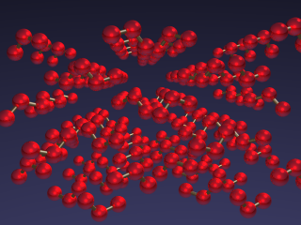
Home
Oxygen is a gas found in nature. It is located at Period 16, Group 2 on the Periodic Table Of Elements. We humans need oxygen in order to live the lives we do. Though humans are not the only ones who need oxygen. Many other organisms need oxygen too.
I chose this element because I find interest in learning about oxygen.
https://www.webelements.com/oxygen/

Slide 4
Location And Neighbors
Nitrogen | Oxygen | Fluorine
Phosphorus | Sulfur | Chlorine
http://www.chemicalelements.com/sup/about.html

Slide 5
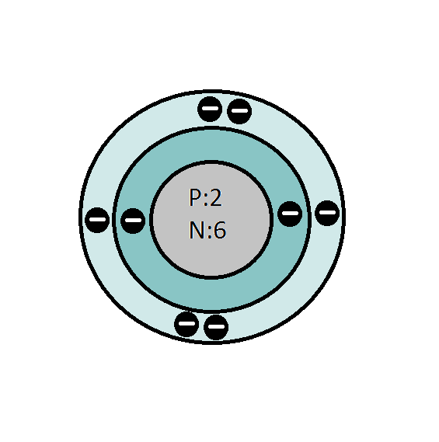
Drawings
Atomic number: 8 {eight}
Mass: 15.9994 {fifteen point nine, nine, nine, four}
Number of protons: 2 {two}
Neutrons: 6 {six}
Electrons: 8 {eight}
Valence Electrons: 6 {six}

Slide 6
Characteristic Properties
Melting Point: -361.12 °F
Boiling Point: -297.4 °F
Color: colorless
Density: 1.429 g/cm3
Classification: Non-metal

Slide 7
Where Found
In 21% of the atmosphere
In the earth's crust
In any number of minerals
In most of the weight of water
As the third most abundant element in the sun
In mars as about 0.15%

Slide 8
Uses
Oxy-acetylene welding
“Gives oxygen to patients in hospitals”
“Makes methanol and ethane oxide”
Rocket fuel oxidant
Steel manufacture
“Ozone layer(O3), {an oxygen layer in the atmosphere that is protection against the sun's ultraviolet rays}”
Breathing
“Is involved in the stellar energy production”

Slide 9
Citations
Bentor, Yinon. "Oxygen (O)." Chemical Elements.com. N.p., Feb. 1996. Web. 10 June 2016. http://www.chemicalelements.com/sup/about.html .
Winter, Mark. "Oxygen: The Essentials." [WebElements Periodic Table]. [The University of Sheffield and WebElements Ltd, UK, Sept. 1993. Web. 10 June 2016. https://www.webelements.com/oxygen/ .

