Slide 1
Aluminum
Drew Fountain
613 Mr. O’Reilly March 28, 2017

Slide 2
Navigation
Home
Where Found
Uses
Location & Neighbors
Drawings
Characteristics

Slide 3
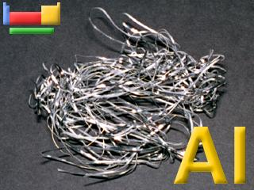
Home
Pure aluminum is a silvery-white metal with many desirable characteristics.
https://www.webelements.com/aluminium/

Slide 4
Location and Neighbors
Beryllium | Boron | Carbon
Magnesium | Aluminum | Silicon
Zinc | Gallium | Germanium
https://www.webelements.com/aluminium/

Slide 5
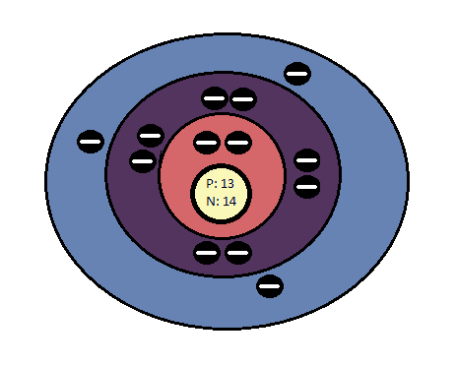
Drawings
Atomic number: 13
Mass:27
Protons: 13
Neutrons:14
Electrons:13
Valence electrons:3

Slide 6
Characteristic Properties
• Melting Point: 933.47 K
• Boiling Point: 2792 K
• Structure: ccp (cubic close-packed)
• Color: silver
• Density: 2700 Kg
• Classification: Metallic

Slide 7
Where Found
abundant element in earth’s crust
obtained from bauxite

Slide 8
Uses
cans and foils
kitchen utensils
outside building decoration
industrial applications
in electrical transmission lines

Slide 9
Citations
Bentor, Yinon. "Chemical Elements.com - Aluminum (Al)." Chemical Elements.com. N.p., Feb. 1996. Web. 01 June 2017. http://www.chemicalelements.com/elements/al.html
Winter, Mark. "Aluminum: The Essentials." WebElements Periodic Table. The University of Sheffield and WebElements Ltd, UK, Sept. 1993. Web. 01 June 2017. https://www.webelements.com/aluminium/

