Slide 1
Copper
April Keyes
611 & Mr. O’Reilly
June 10, 2016

Slide 2
Navigation
Home
Where Found
Uses
Characteristics
Locations & Neighbors
Drawings

Slide 3
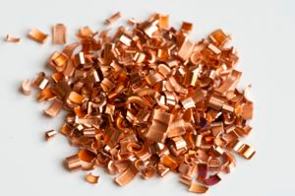
Home
I chose copper, in the fact that it has many interesting qualities, such as the ability to conduct heat and electricity, is malleable, and ductile.
https://www.webelements.com/_media/elements/element_pictures/Cu.jpg

Slide 4
Locations and Neighbors
Nickel | Copper | Zinc
Palladium | Silver | Cadmium
Iridium | Platinum | Gold
https://www.webelements.com/copper/

Slide 5
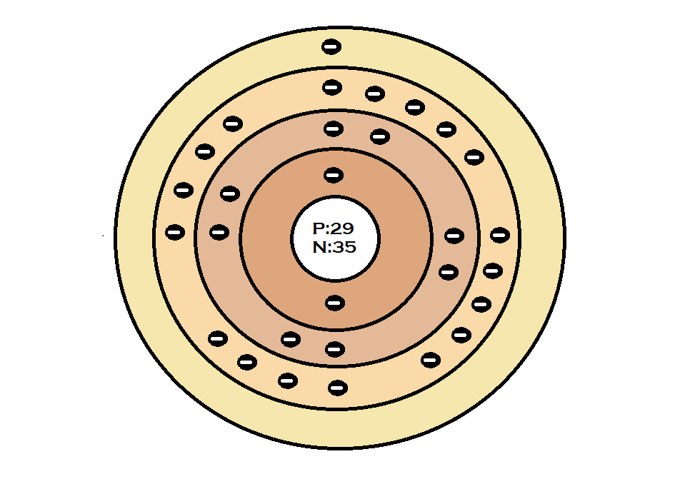
Drawings
Atomic Number
Mass
Number of Protons
Neutrons
Electrons
Valence Electrons

Slide 6
Characteristics
• Melting Point ~ 1083.0 °C (1981.4 °F)
• Boiling Point ~ 2567.0 °C (4652.6 °F)
• Crystal Structure ~ Cubic
• Color ~ Red/orange
• Density ~ 8.96 g/cm3
• Classification ~ Transition Metal

Slide 7
Where Found
“Sometimes found as the free element and is present in many minerals”
Copper is found in:
Canada
Chile
Germany
Italy
Peru
U.S.A.
Zambia
Zaire

Slide 8
Uses
Wire
Coinage metal
The electrical industry
“Copper sulphate is an agricultural poison, and water purifier.”

Slide 9
Citations
Bentor, Yinon. "Copper (Cu)." Chemical Elements.com. N.p., Feb. 1996. Web. 10 June 2016. http://www.chemicalelements.com/elements/cu.html
Winter, Mark. "Copper: The Essentials." WebElements Periodic Table]. [The University of Sheffield and WebElements Ltd, UK], Sept. 1993. Web. 10 June 2016. https://www.webelements.com/copper/

