Slide 1
Germanium
Matthew Bergin
615 & Miss Dougherty
June 9, 2017

Slide 2
Navigation
Home
Characteristic Properties
Uses
Where Found
Location & Neighbors
Drawings

Slide 3
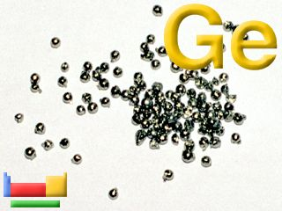
Home
                https://www.webelements.com/germanium/
Germanium is a semi-metal that is used
for many things, such as a catalyst.

Slide 4
Location & Neighbors
Aluminum | Silicon | Phosphorus
Gallium | GERMANIUM | Arsenic
Indium | Tin | Antimony
https://www.webelements.com/germanium/

Slide 5
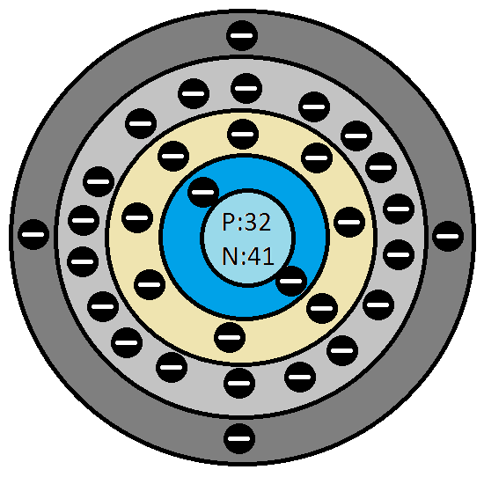
Drawings
Atomic Number:32
Mass:71.61 AMU
Protons:32
Neutrons:41
Electrons:32
Valence Electrons:4
http://www.chemicalelements.com/elements/ge.html
Drawing
Information

Slide 6
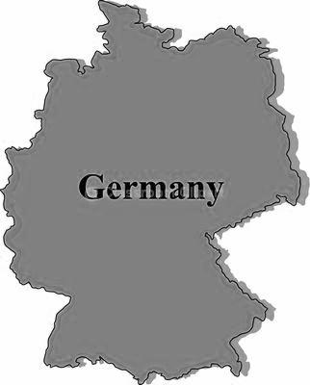
Where Found
Found in the ores of Germinate, Argyrodite, Coal, Lead, and some Zinc ores
  Found by refining these ores
Found in Germany
http://www.chemicalelements.com/elements/ge.html

Slide 7
Characteristic Properties
Color: Grayish
Symbol: Ge
Melting Point: 937.4 °C (1210.55 K, 1719.3201 °F)
Boiling Point: 2830.0 °C (3103.15 K, 5126.0 °F)
Atomic Number: 32
Relative Atomic Mass: 72.61amu
Classification: Metalloid
Density: 5.323 g/cm³
State: Solid
Crystal Structure: Cubic
http://www.chemicalelements.com/elements/ge.html

Slide 8
Uses
Used as a transistor element
Semiconductor
Alloying agent
Phosphor in fluorescent lamps
In infrared spectroscopes
sensitive infrared detectors
wide-angle camera and microscope lenses
Possible chemotherapy applications
Gamma-radiation detector
https://www.webelements.com/germanium/

Slide 9
Citations
Bentor, Yinon. "Germanium (Ge)." Chemical Elements.com - Germanium (Ge). N.p., Feb. 1996. Web. 02 June 2017. http://www.chemicalelements.com/elements/ge.html .
Winter, Mark. "Germanium: The Essentials." Germanium»the Essentials [WebElements Periodic Table]. Copyright 1993-2016 Mark Winter [The University of Sheffield and WebElements Ltd, UK]. , Sept. 1993. Web. 02 June 2017. https://www.webelements.com/germanium/ .

