Slide 1
Boron
Zachary Lindsay
6-15 Mr.O’Reilly
June 9, 2017

Slide 2
Navigation
Home
Where Found
Uses
Location and Neighbors
Drawings
Characteristic properties

Slide 3
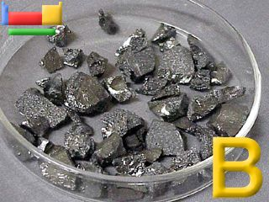
Home
BORON
Boron was discovered in 1808.
https://www.webelements.com/boron/

Slide 4
Locations and Neighbors
Beryllium |  | Carbon
Magnesium | Aluminum | Silicon
BORON
https://www.webelements.com/boron/

Slide 5
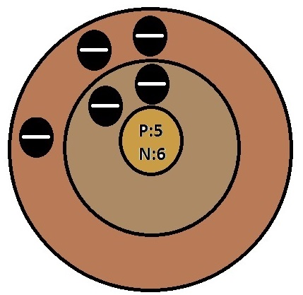
Drawings
Drawing
Information
Atomic number:5
Mass:10.811
Protons:5
Neutrons:6
Electrons:5
Valance electrons:3
https://www.webelements.com/boron/

Slide 6
Characteristic Properties
Melting Point:4172.0 °F
Boiling Point: 4622.0 °F
Color: Brownish
Density:2.34g
Classification: Metalloid
https://www.webelements.com/boron/

Slide 7
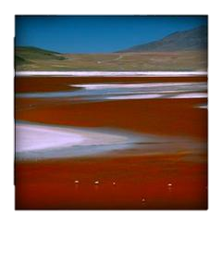
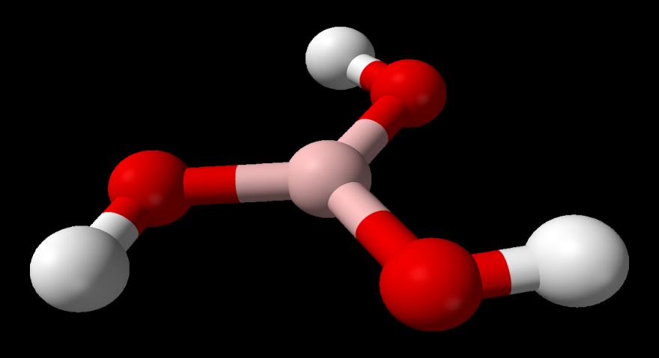
Where Found
orthoboric acid
volcanic spring waters
natural fibre optic
borates in borax
Found in the USA
Volcanic spring waters
Orthoboric acid
https://www.webelements.com/boron/geology.html

Slide 8
Uses
amorphous
In rockets (as an igniter)
boric, or boracic, acid
borax
refrigerators (Cover seal)
washing machines (Cover seal)
Enamels
borosilicate glasses
treating arthritis
nuclear reactors
Boron filaments
https://www.webelements.com/boron/

Slide 9
Citations
Bentor, Yinon. "Boron (B)." Chemical Elements.com. N.p., Feb. 1996. Web. 02 June 2017. http://www.chemicalelements.com/elements/b.html .
Winter, Mark. "Boron: The Essentials." Boron»the Essentials [WebElements Periodic Table] . The University of Sheffield and WebElements Ltd, UK, Sept. 1993. Web. 02 June 2017. https://www.webelements.com/boron/ .

